Slide 1
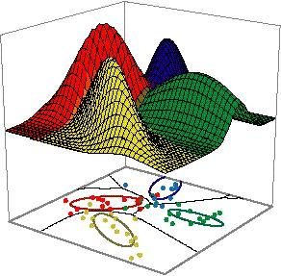
Week 12: Machine Learning
Evaluation metric
Algorithms that learn to make predictions from examples (data)

Slide 2
Model Evaluation

Slide 3
Metrics for Performance Evaluation
Focus on the predictive capability of a model
Rather than how fast it takes to classify or build models, scalability, etc.
Confusion Matrix:
 | PREDICTED CLASS
ACTUAL CLASS |  | Class=Yes | Class=No
 | Class=Yes | a (TP) | b (FN)
 | Class=No | c (FP) | d (TN)
a: TP (true positive)
b: FN (false negative)
c: FP (false positive)
d: TN (true negative)

Slide 4
Metrics for Performance Evaluation…
 | PREDICTED CLASS
ACTUAL CLASS |  | Class=Yes | Class=No
 | Class=Yes | a (TP) | b (FN)
 | Class=No | c (FP) | d (TN)
Most widely-used metric:

Slide 5

Confusion Matrix
Confusion matrix of Algorithm for predicting heart disease :
 | PREDICTED CLASS
ACTUAL CLASS |  | Has heart Disease | Not have heart Diseases
 | Has heart Disease | 142 (TP) | 29 (FN)
 | Not have heart Diseases | 22 (FP) | 110 (TN)
$$Accuracy= \frac{142+110}{142+29+22+110}=\frac{252}{303}=83 \%$$

Slide 6

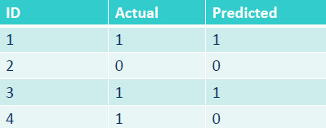
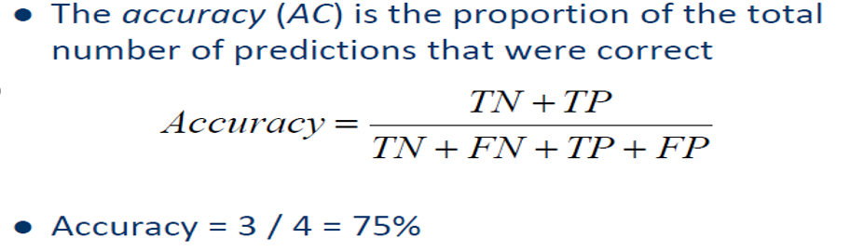
Confusion Matrix
Confusion Matrix
Confusion matrix of below table is shown at right side :
Notes:
Accuracy Example: Agent Wining Accuracy, Bank loan default accuracy.

Slide 7
Limitation of Accuracy
Consider a 2-class problem
Number of Class 0 examples = 9990
Number of Class 1 examples = 10
If model predicts everything to be class 0, accuracy is 9990/10000 = 99.9 %
Accuracy is misleading because model does not detect any class 1 example

Slide 8

Sensitivity/ Recall / True positive rate
Sensitivity/recall or true positive rate is the proportion of positive cases that were correctly predicted.
$$TPR= \frac{TP}{TP+FN}$$
 | PREDICTED CLASS
ACTUAL CLASS |  | Class=Yes | Class=No
 | Class=Yes | a (TP) | b (FN)
 | Class=No | c (FP) | d (TN)

Slide 9



Specificity and False Positive rate
Specificity is the proportion of negative cases that were correctly predicted.
$$Specificity= \frac{TN}{FP+TN}$$
$$FPR=1 −Specificity= \frac{FP}{FP+TN}$$
 | PREDICTED CLASS
ACTUAL CLASS |  | Class=Yes | Class=No
 | Class=Yes | a (TP) | b (FN)
 | Class=No | c (FP) | d (TN)
$$Specificity$$

Slide 10

Precision
$$Precision= \frac{TP}{TP+FP}$$
 | PREDICTED CLASS
ACTUAL CLASS |  | Class=Yes | Class=No
 | Class=Yes | a (TP) | b (FN)
 | Class=No | c (FP) | d (TN)

Slide 11
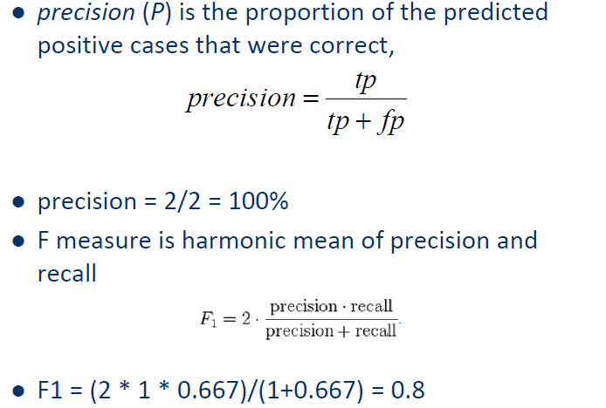
F-Score

Slide 12






$$recall TPR= \frac{TP}{TP+FN}$$
 | PREDICTED CLASS
ACTUAL CLASS |  | Has heart Disease | Not have heart Diseases
 | Has heart Disease | 142 (TP) | 29 (FN)
 | Not have heart Diseases | 22 (FP) | 110 (TN)
$$R= \frac{142}{142+29}=83.0\%$$
$$Specificity= \frac{TN}{FP+TN}$$
$$Specificity= \frac{110}{22+110}=83.3 \%$$
$$Precision= \frac{TP}{TP+FP}$$
$$P= \frac{142}{142+22}=86.5\%$$
Notes:
Precision measures the accuracy of positive predictions, while recall measures the completeness of positive predictions.

Slide 13
Receiver Operating Characteristic Curve (ROC) Analysis
Historical Development

Slide 14
ROC Analysis: Historical Development (1)
Derived from early radar in WW2 Battle of Britain to address: Accurately identifying the signals on the radar scan to predict the outcome of interest – Enemy planes – when there were many extraneous signals (e.g. Geese)?
Notes:
1. ROC is a signal detection technique (Exploratory or hypothesis generating)
2. 3. Very easy to understand the ROC through the idea of how well a diagnositc test identifes an illness.
4. But of course it is not restricted to test evaluation
5. Same technique can be Also used outcome of many sorts etc.
Where we think of diagnostic test=predictor
Disease=outcome of interest (Binary outcome)
SO WHY NOT DO A SIMPLE LOGISTIC REGRESSION WHICH IS A REGRESSION WHICH CAN DEAL WITH BINARY OUTCOMES?
Great article by Helena, etc.comparing logistic regression and ROC analysis entilted

Slide 15
ROC Analysis: Historical Development (2)
True Positives = Radar Operator interpreted signal as Enemy Planes and there were Enemy planes (Good Result: No wasted Resources)
True Negatives = Radar Operator said no planes and there were none (Good Result: No wasted resources)
False Positives = Radar Operator said planes, but there were none (Geese: wasted resources)
False Negatives = Radar Operator said no plane, but there were planes (Bombs dropped: very bad outcome)
Notes:
Hand out handout on these

Slide 16
ROC Analysis: Historical Development
Sensitivity = Probability of correctly interpreting the radar signal as Enemy planes among those times when Enemy planes were actually coming
SE = True Positives / True Positives + False Negatives
Specificity = Probability of correctly interpreting the radar signal as no Enemy planes among those times when no Enemy planes were actually coming
SP = True Negatives / True Negatives + False Positives
Notes:
Handout ROC curve is essentially plotting sensitivity against specificity.
As you can see in the top right hand corner is the ideal

Slide 17
ROC: Prediction of Enemy Planes by RAF Radar Operators
Notes:
Green or Red is what you want;
False positive- waste of fuel and pilots
False negative: bombs fall

Slide 18
ROC Plane and “Curve”
Ideal Point
ROC “curve”
Random ROC
(Q,Q)
(P,P)

Slide 19
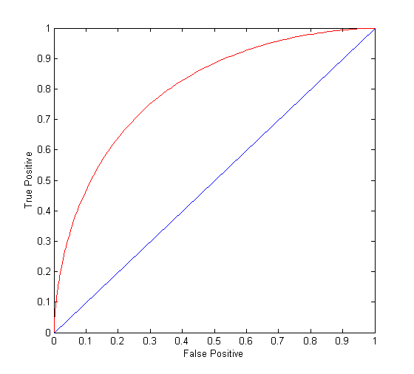
ROC Curve
(TP,FP):
(0,0): declare everything to be negative class
(1,1): declare everything to be positive class
(1,0): ideal
Diagonal line:
Random guessing
Below diagonal line:
prediction is opposite of the true class

Slide 20
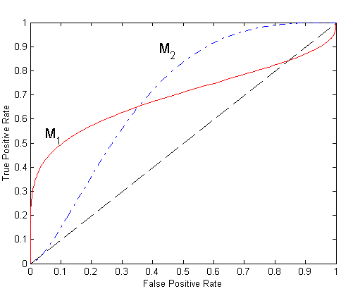
Using ROC for Model Comparison
No model consistently outperform the other
M₁ is better for small FPR
M₂ is better for large FPR
Area Under the ROC curve
Ideal:
Area = 1
Random guess:
Area = 0.5

